Slide 1
CHART PROJECT one in a lifetime experience
IHO – NIPPON FOUNDATION
ALUMNI SEMINAR
NIKOLAY LYASKOVSKI
BULGARIA

Slide 2
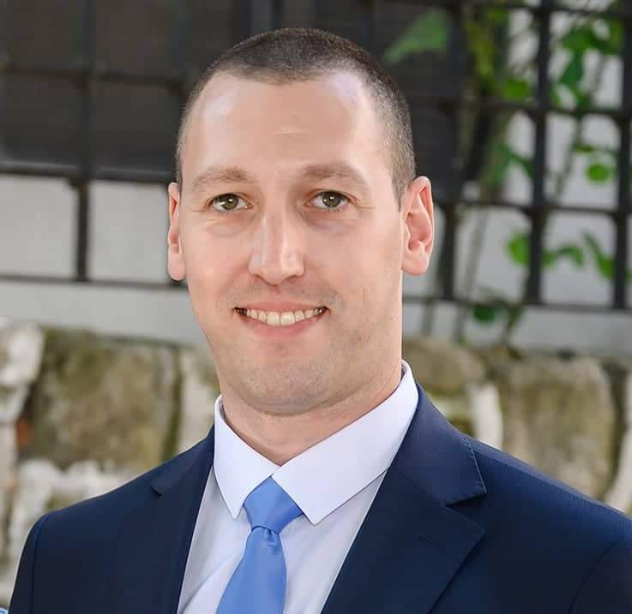
Self introduction
IHO – NIPPON FOUNDATION
ALUMNI SEMINAR
Name | NIKOLAY RADOSLAVOV LYASKOVSKI
Alumni year | 2013
Country | BULGARIA
Organization | HIDROGRAFSKA SLUZHBA PRI MINISTERSTVO NA OTBRANATA ( Navy Hydrographic Service )
Position/Job title | Head of section HYDROGRAPHY
Current job description | Responsible for collecting hydrographic survey data and lead a hydrographic team.Part of the charting and compiling processes alongside with Cartographic section.
Please put your photo here!

Slide 3
My career path and projects / Achievements
IHO – NIPPON FOUNDATION
ALUMNI SEMINAR
CAREER PATH
Bachelor and Master degree from Naval Academy (2003 – 2012)
Head of hydrographic section conducted surveys in port areas, territorial sea of Bulgaria in Black Sea (2008 – now)
Chart project alumni in 2013 (start working on charting and compiling processes alongside with Cartographic section)

Slide 4
My career path and projects / Achievements
IHO – NIPPON FOUNDATION
ALUMNI SEMINAR
ACHIEVEMENTS
Regional Training Course on Hydrography and Hydrography Governance – 2014 Romania
ESA PECS SAR Course in Sofia (2016)
Member of the National Oceanographic Commission Bulgaria

Slide 5
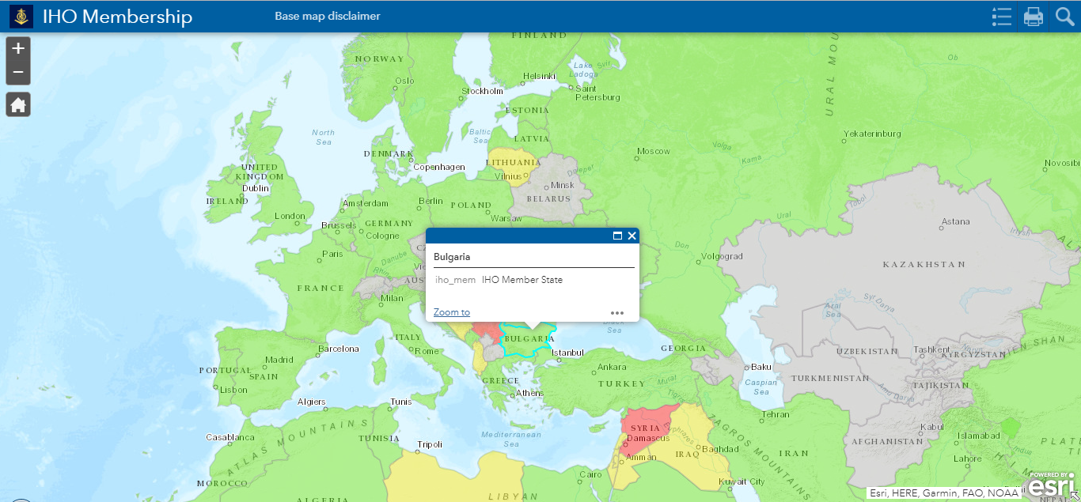
My career path and projects / Achievements
IHO – NIPPON FOUNDATION
ALUMNI SEMINAR
ACHIEVEMENTS
Bulgaria - IHO full member

Slide 6
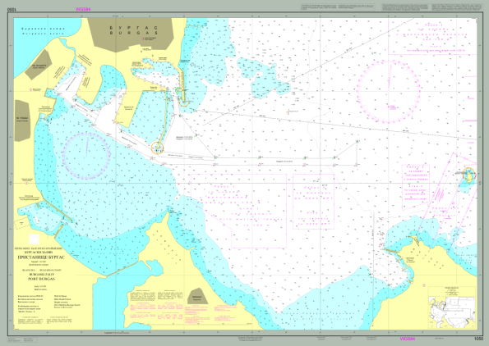
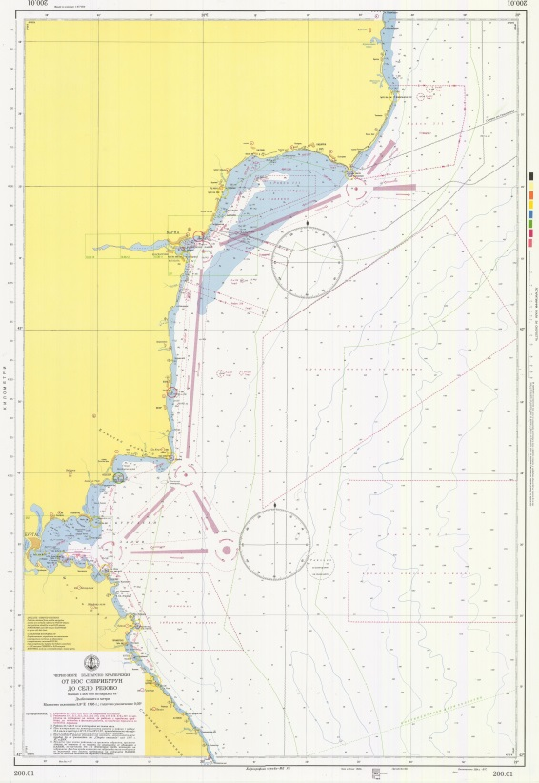
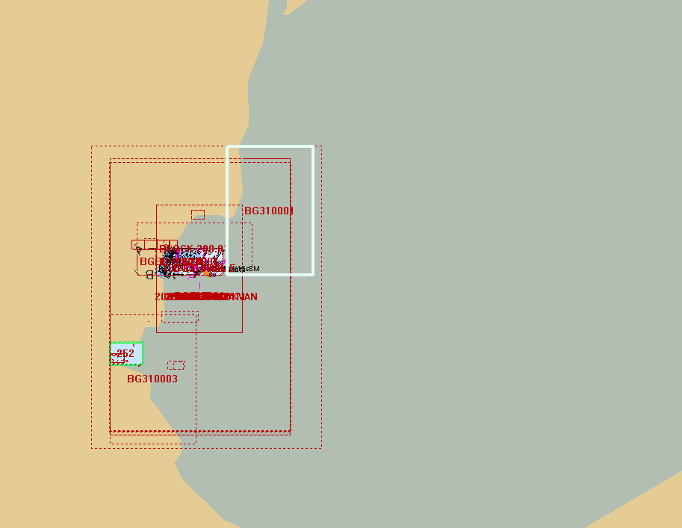
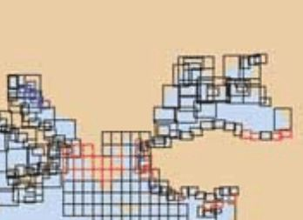
My career path and projects / Achievements
IHO – NIPPON FOUNDATION
ALUMNI SEMINAR
NEAR FUTURE
Update national chart series
New ENC

Slide 7
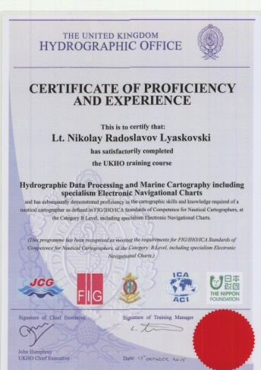
My career path and projects / Achievements
IHO – NIPPON FOUNDATION
ALUMNI SEMINAR
NEAR FUTURE
INT charts
Next level of education
Cat A

Slide 8
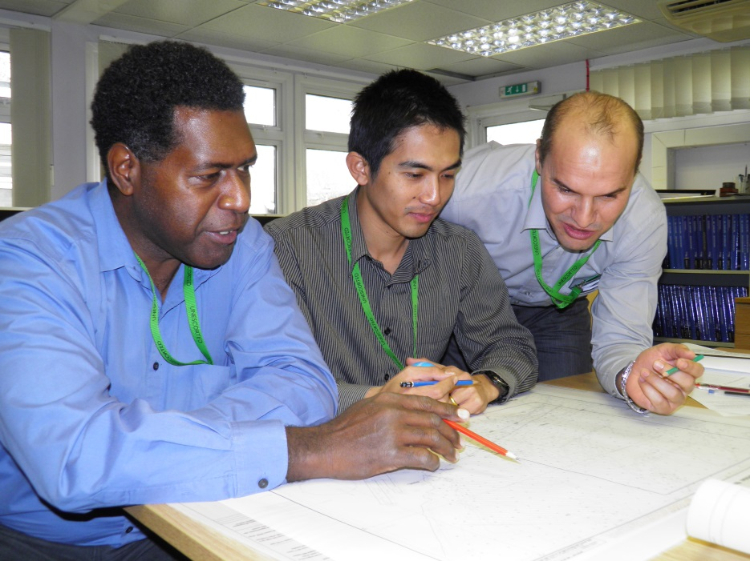
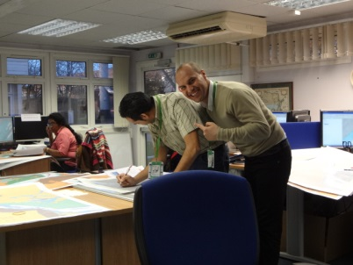
Lessons learned from CHART Course
IHO – NIPPON FOUNDATION
ALUMNI SEMINAR
Team work
Cooperation

Slide 9
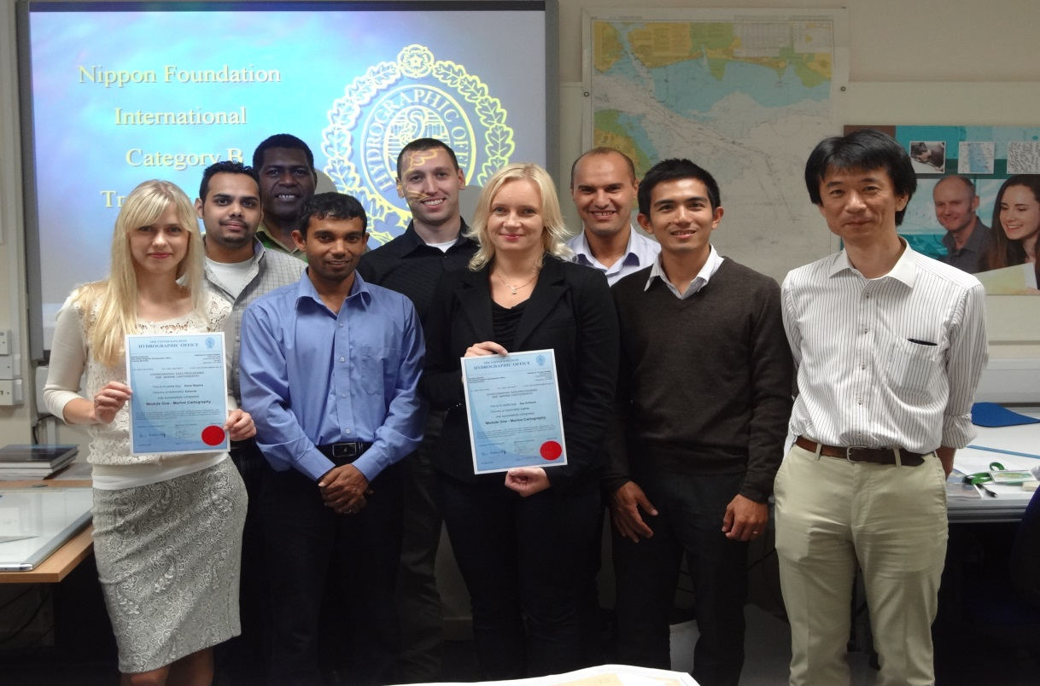
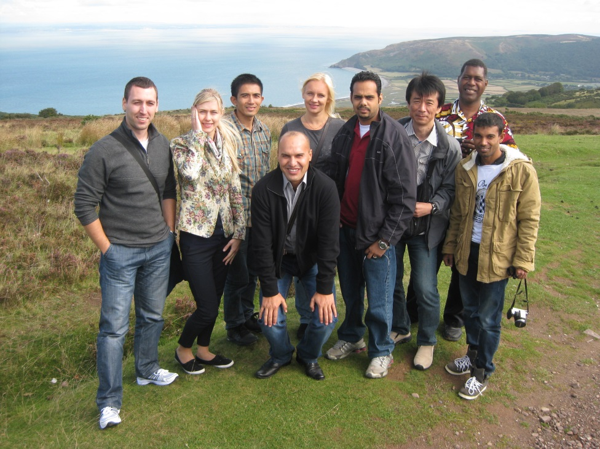
Lessons learned from CHART Course
IHO – NIPPON FOUNDATION
ALUMNI SEMINAR
Constant improvement
Friends

Slide 10
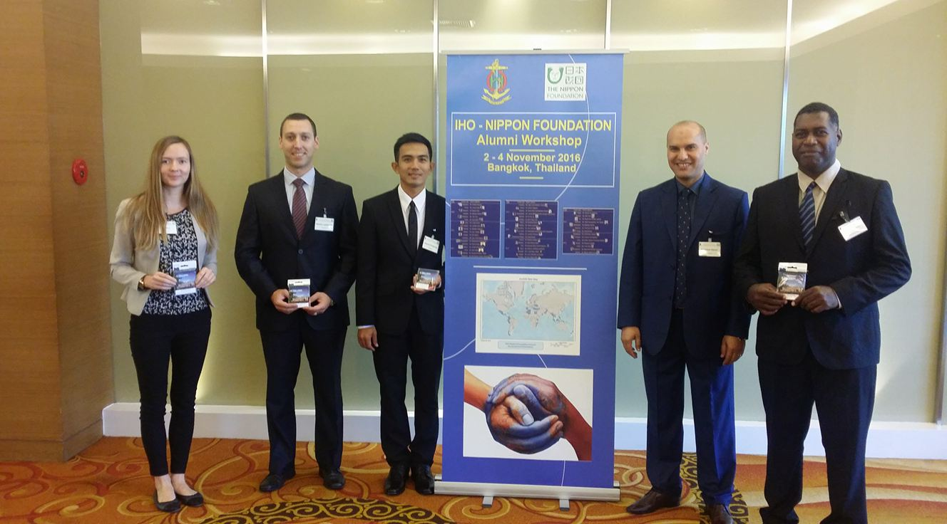
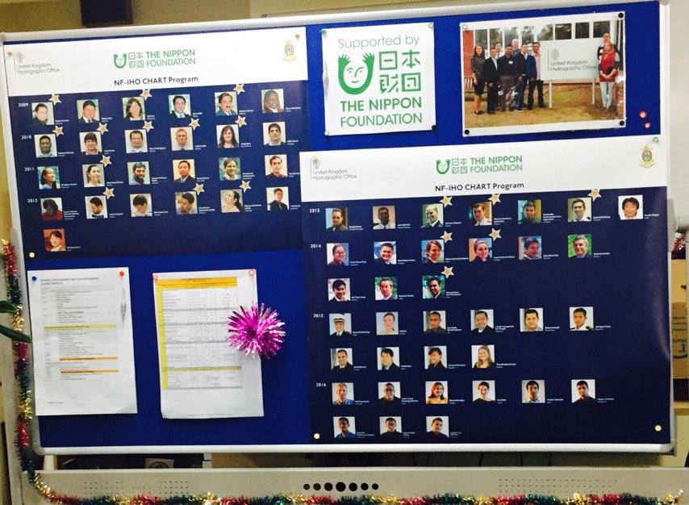
Suggestion for the future
IHO – NIPPON FOUNDATION
ALUMNI SEMINAR
Alumni network
Social media
Web based forum/site

Slide 11
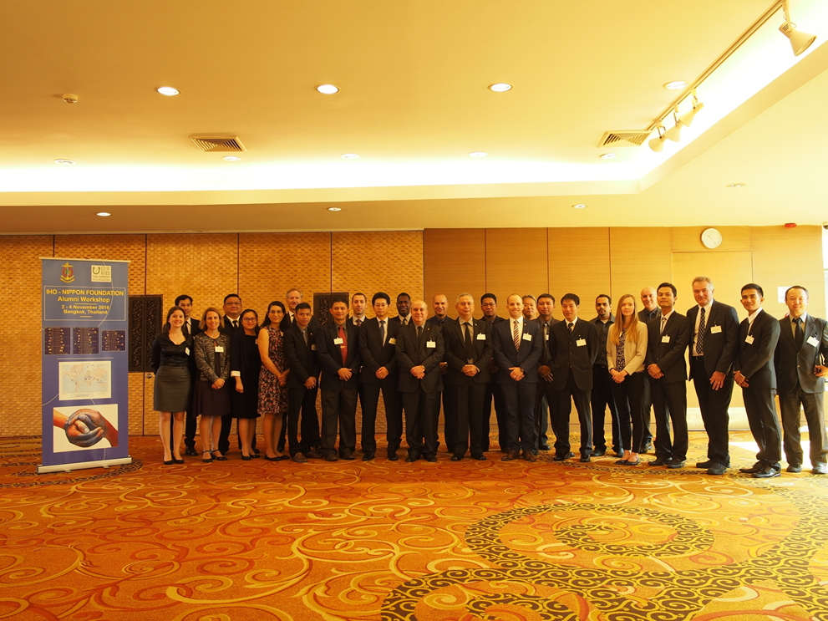
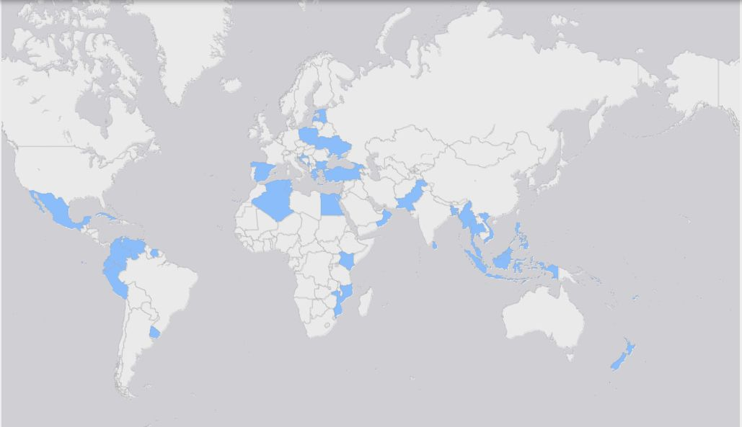
My CHART Family
IHO – NIPPON FOUNDATION
ALUMNI SEMINAR

Slide 12
IHO – NIPPON FOUNDATION
ALUMNI SEMINAR
THANK YOU

